Slide 1
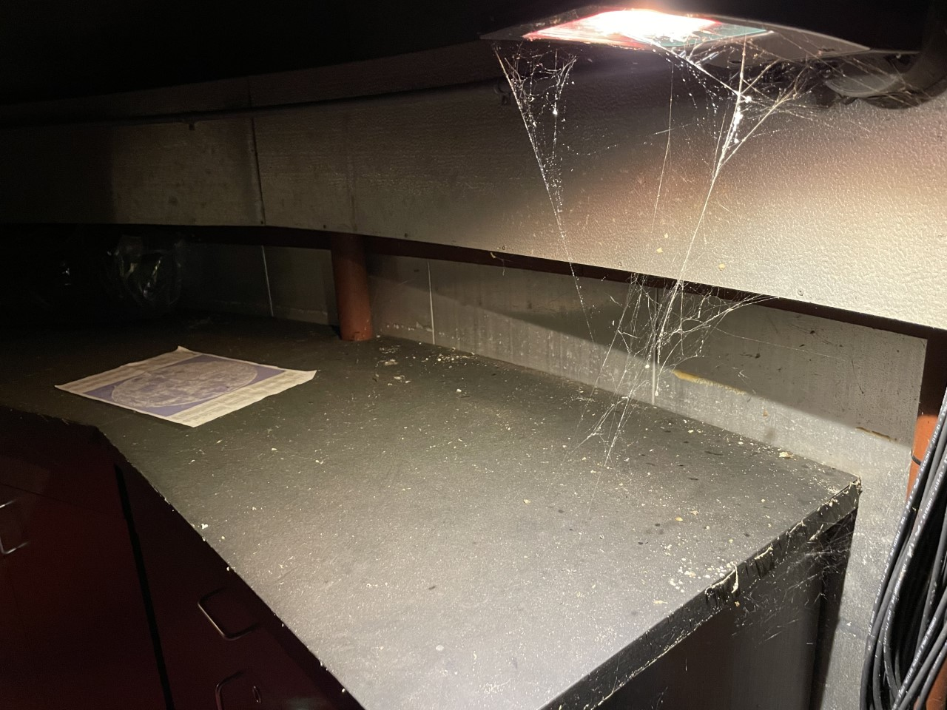
SPIDAR: Spectroscopic Imaging Data Analysis Routine
Student: Vladimir Khabaev, Community College of Rhode Island (CCRI)
Mentor: Gaurav Khanna, University of Rhode Island (URI)
Researcher: Brendan Britton, CCRI
July 7, 2021

Slide 2
SPIDAR: Spectroscopic Imaging Data Analysis Routine
PROJECT GOALS
Observational: Reproduce legacy Astronomical results from a small college observatory
Computational: Develop data analysis pipeline for small-telescope spectroscopy (SPIDAR)
roject: redshift measurement of Quasar 3C273

Slide 3
Data Analysis Software: IRAF
IRAF: Image Reduction & Analysis Facility
Software for processing astronomical CCD images
Runs on UNIX/LINUX shell
User command line input required
Developed by NOAO in 80s
Archaic, gnarly, and fun!

Slide 4
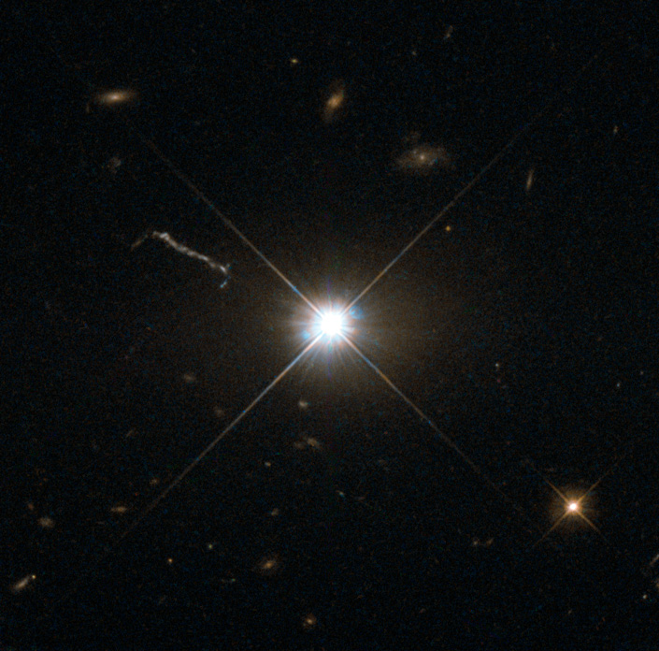
3C273 seen from Hubble Space Telescope

Slide 5
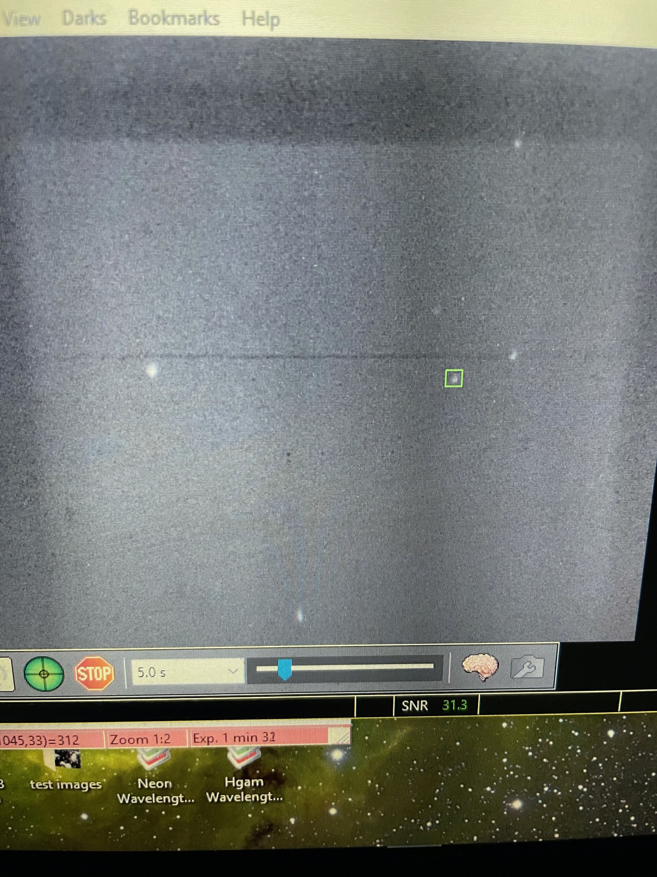
3C273 seen from our “Humble Space Telescope”
3C273

Slide 6
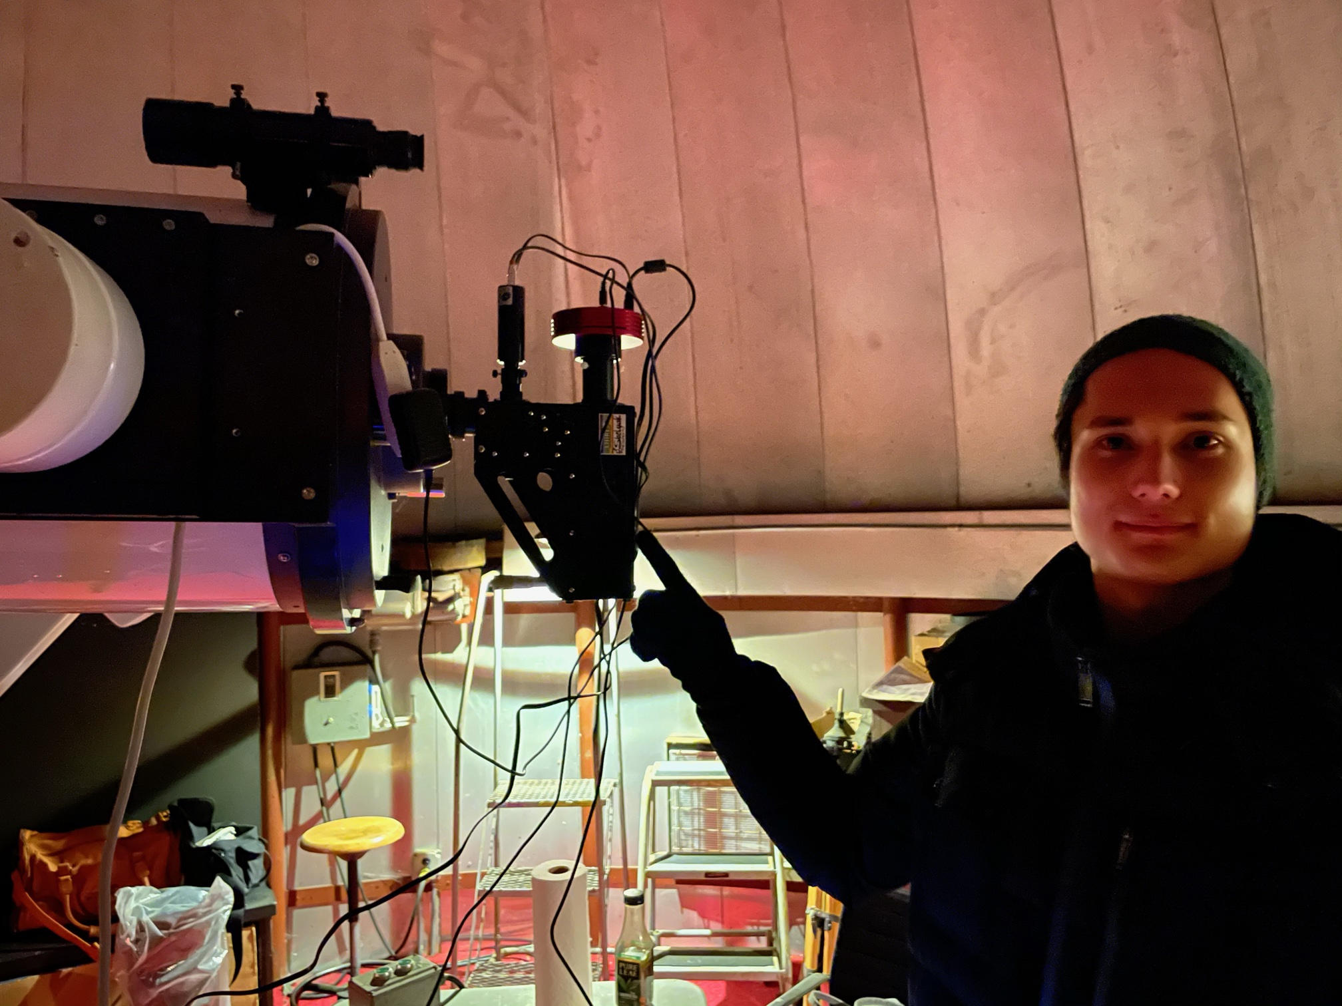
LHIRES III in situ
Margret Jacoby Observatory: 16-inch SCT Reflector, with LHIRES Spectrograph
Vladimir

Slide 7
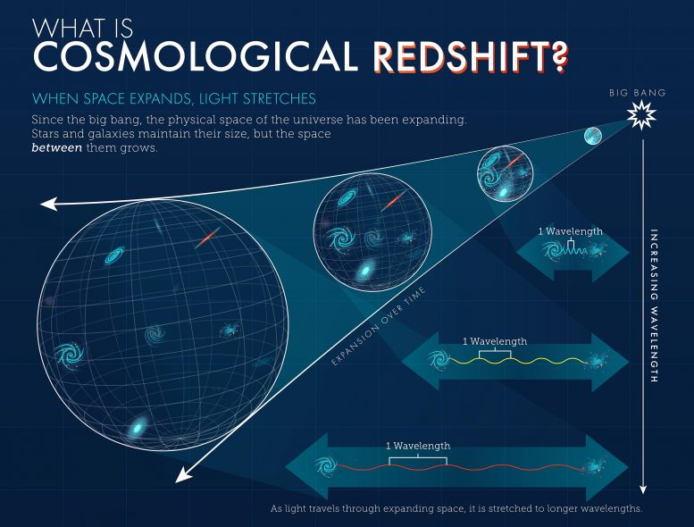
Measuring cosmological redshift

Slide 8
Hβ
Hδ
Hγ
Hα

Slide 9
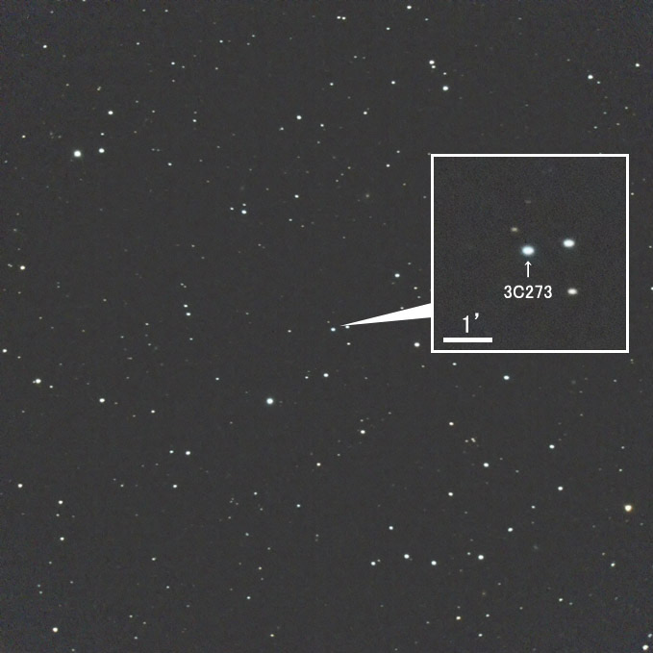
3C273 identifying map

Slide 10
5 sec exposure of star Arcturus
Slit axis
Red end
Blue end
Spectral axis (wavelength)

Slide 11
Raw data 10min exposure of 3C273

Slide 12
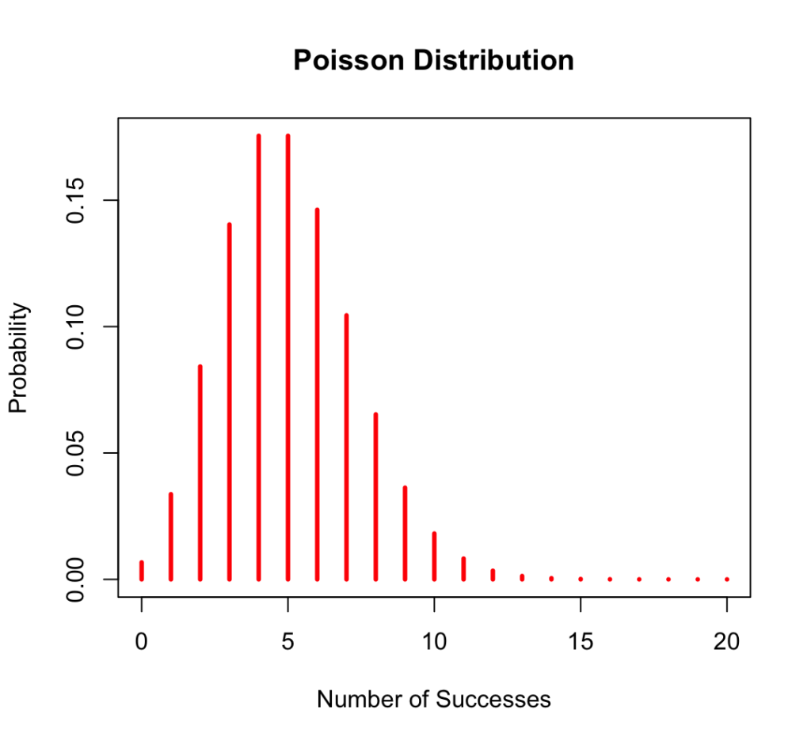
Photon collection obeys Poisson statistics!
$$μ∝exposure time$$
$$σ∝\sqrt{exposure time}$$
$$μ/σ∝\sqrt{exposure time}$$

Slide 13
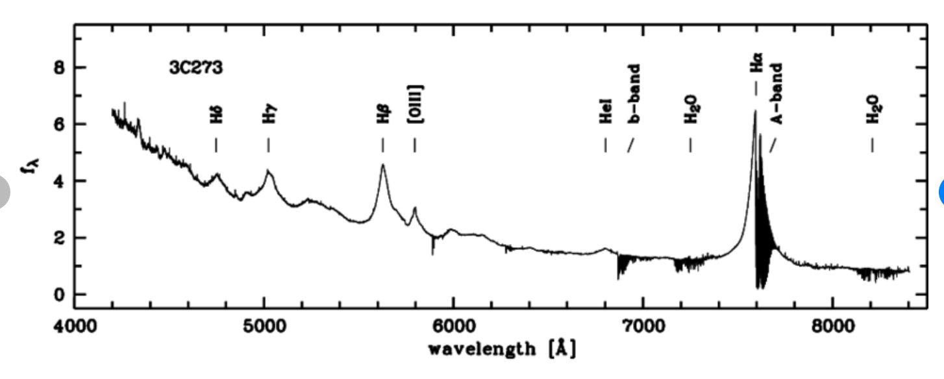
Full spectrum of 3C273
North et. al, Astronomy and Astrophysics · October 1999

Slide 14
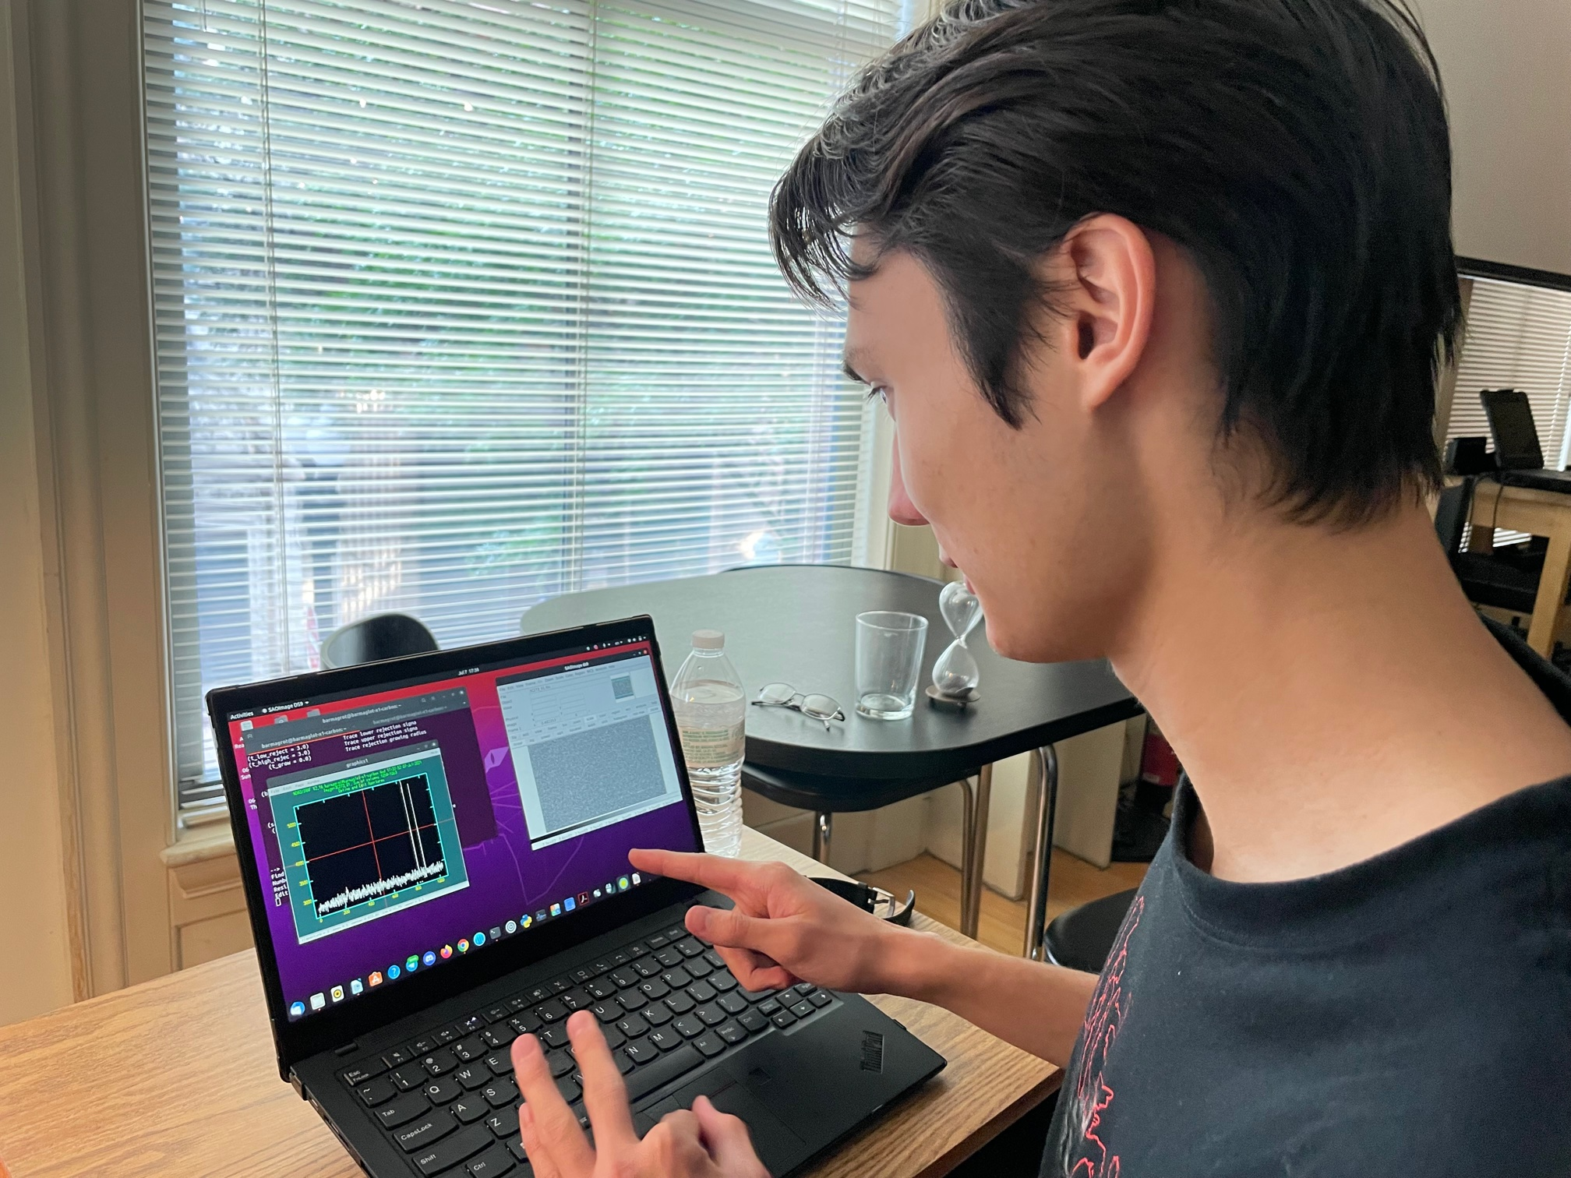
IRAF processing: personal laptops / local machines

Slide 15
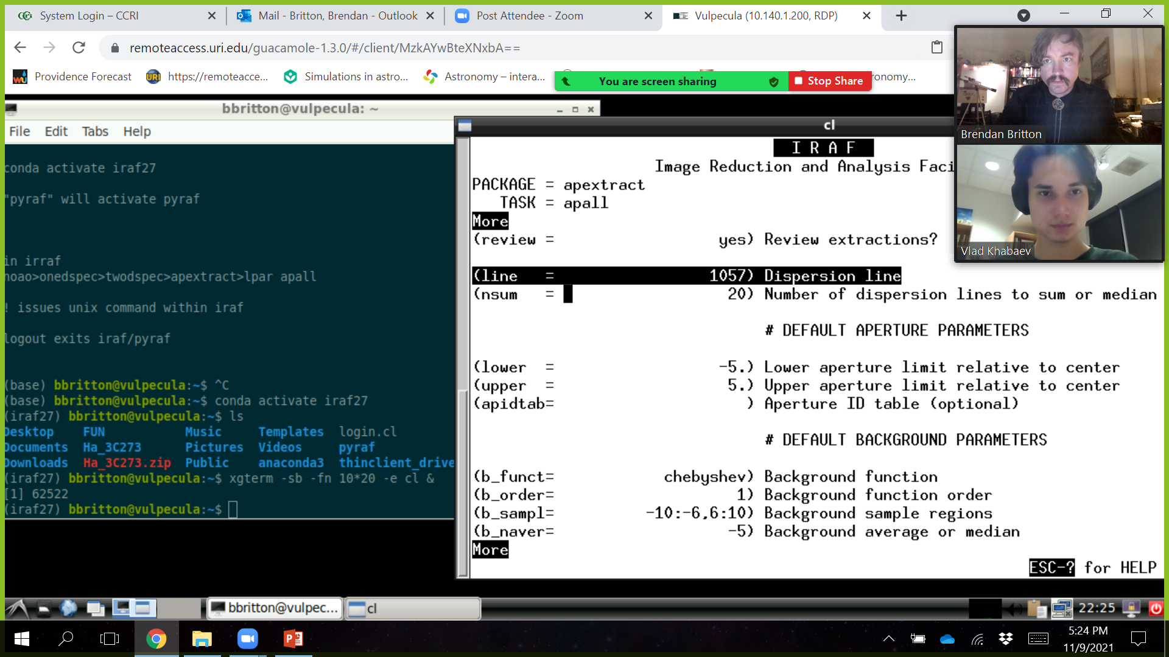
Computational workflow: Virtual LINUX machine thru URI computing facilities

Slide 16
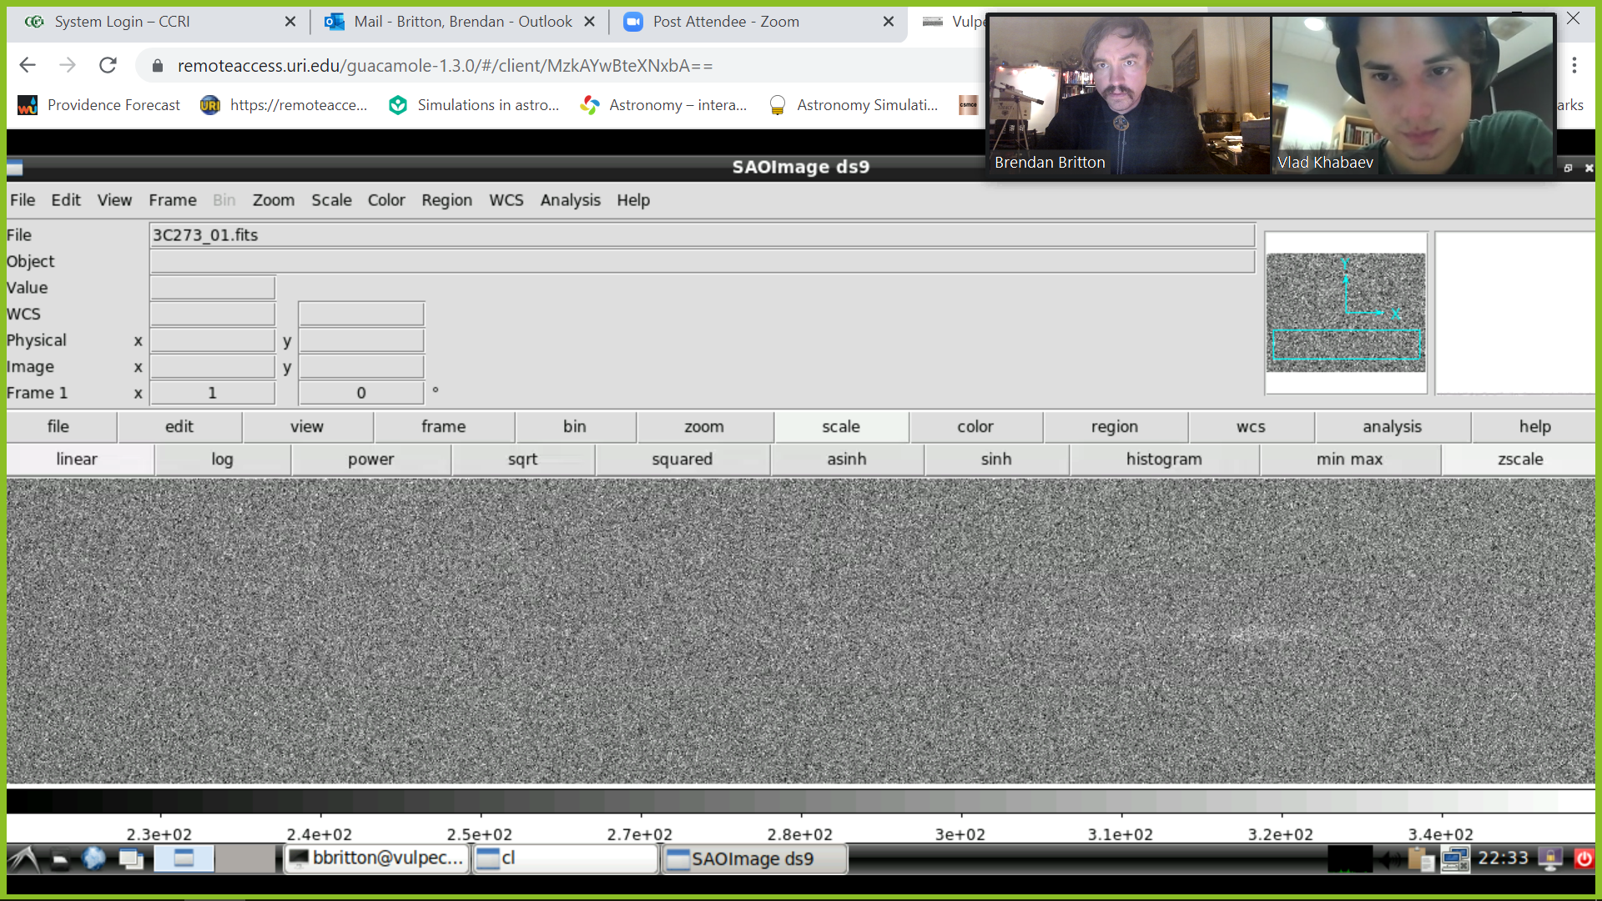
Computational workflow: Virtual LINUX machine thru URI computing facilities

Slide 17
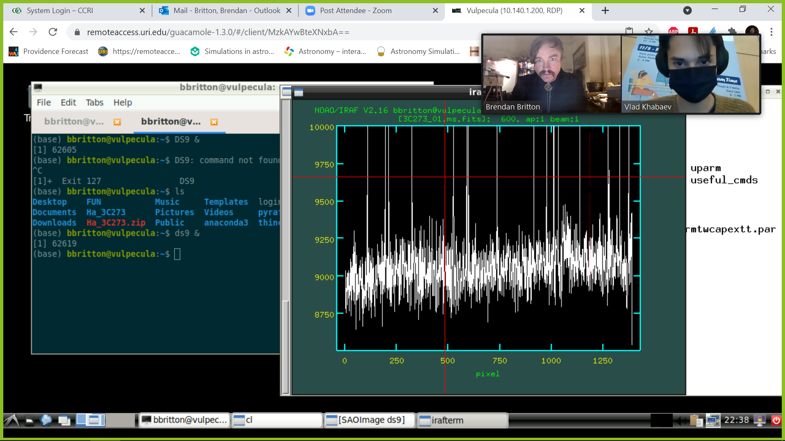
Computational workflow: Virtual LINUX machine thru URI computing facilities

Slide 18
Amazon cloud computing services:
URI-funded virtual machine workstation
Excellent for Covid-era collaboration
Integrates nicely with Zoom for distance collab.
Cost: $120/mo. 24-7 remote access

Slide 19
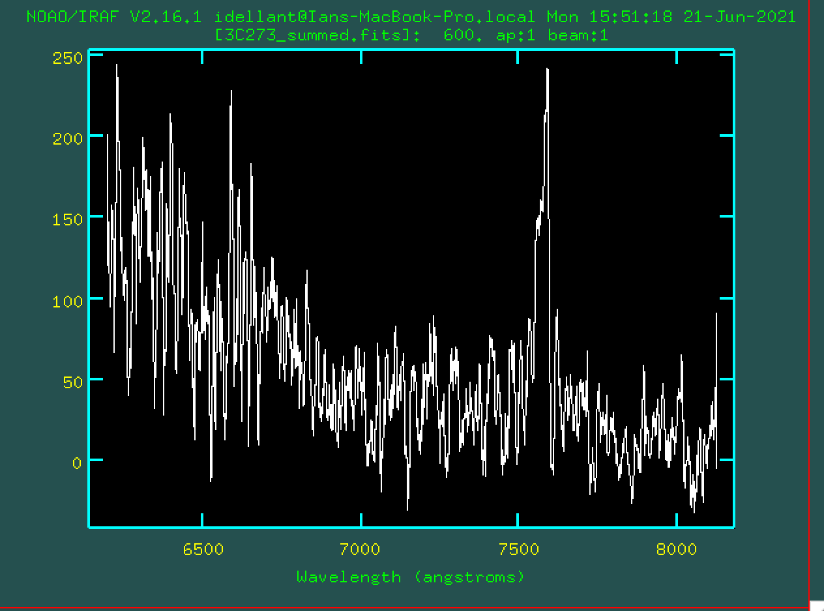
3C273 H-α 7-10min spectrum stack
Results

Slide 20
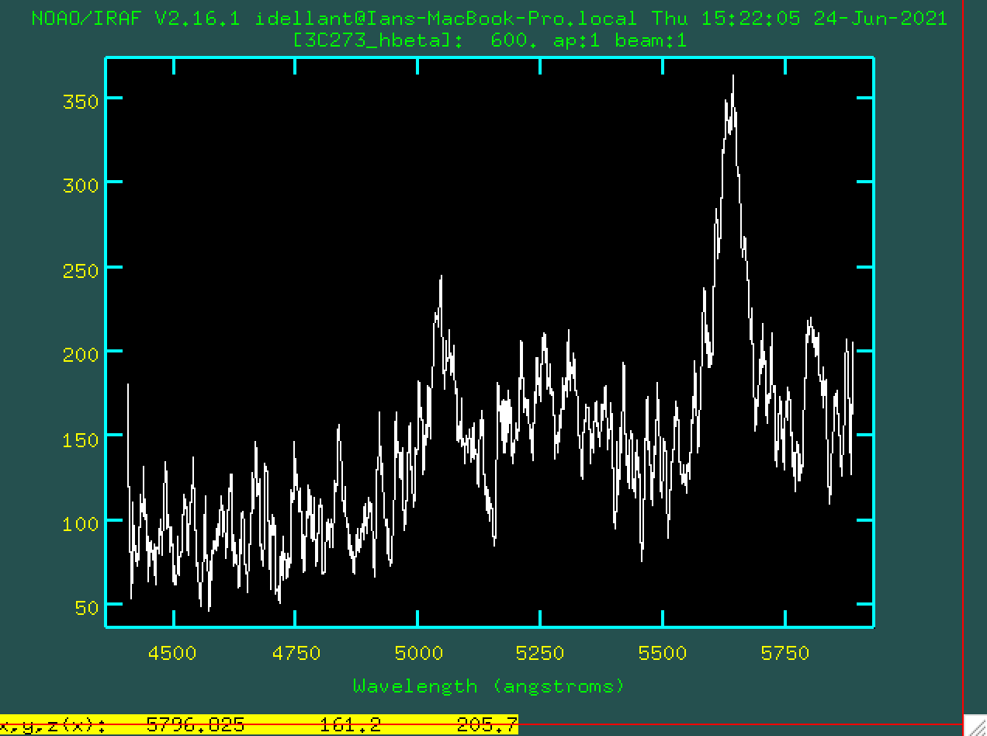
3C273 H-β 7-spectrum stack
Results

Slide 21
Results
H-alpha
Hα λ=7945Å (Rest H α is at λ=6563Å)
Redshift of z=0.156
Current best estimate is z=0.158
H-beta
Hβ λ=5633Å (Rest Hβ is at λ=4861Å)
Redshift of z=0.1588
Current best estimate is z=0.1583

Slide 22
SPIDAR SPectroscopic Imaging Data Analysis Routine
THE END
Student: Vladimir Khabaev, Community College of Rhode Island (CCRI)
Mentor: Gaurav Khanna, University of Rhode Island (URI)
Researcher: Brendan Britton, CCRI
July 7, 2021

