Slide 1
Development of personalized healthy food incentives to improve diet and cardiovascular risk
Student: Anthony Francisco, University of Rhode Island
Mentor: Dr. Gaurav Khanna, University of Rhode Island
Researcher: Dr. Maya Vadiveloo, University of Rhode Island

Slide 2
Smartcart
Smartcart is a personalized meal planning app designed to cater to individual dietary preferences, allergies, and nutritional goals, making healthy eating simple and enjoyable.

Slide 3
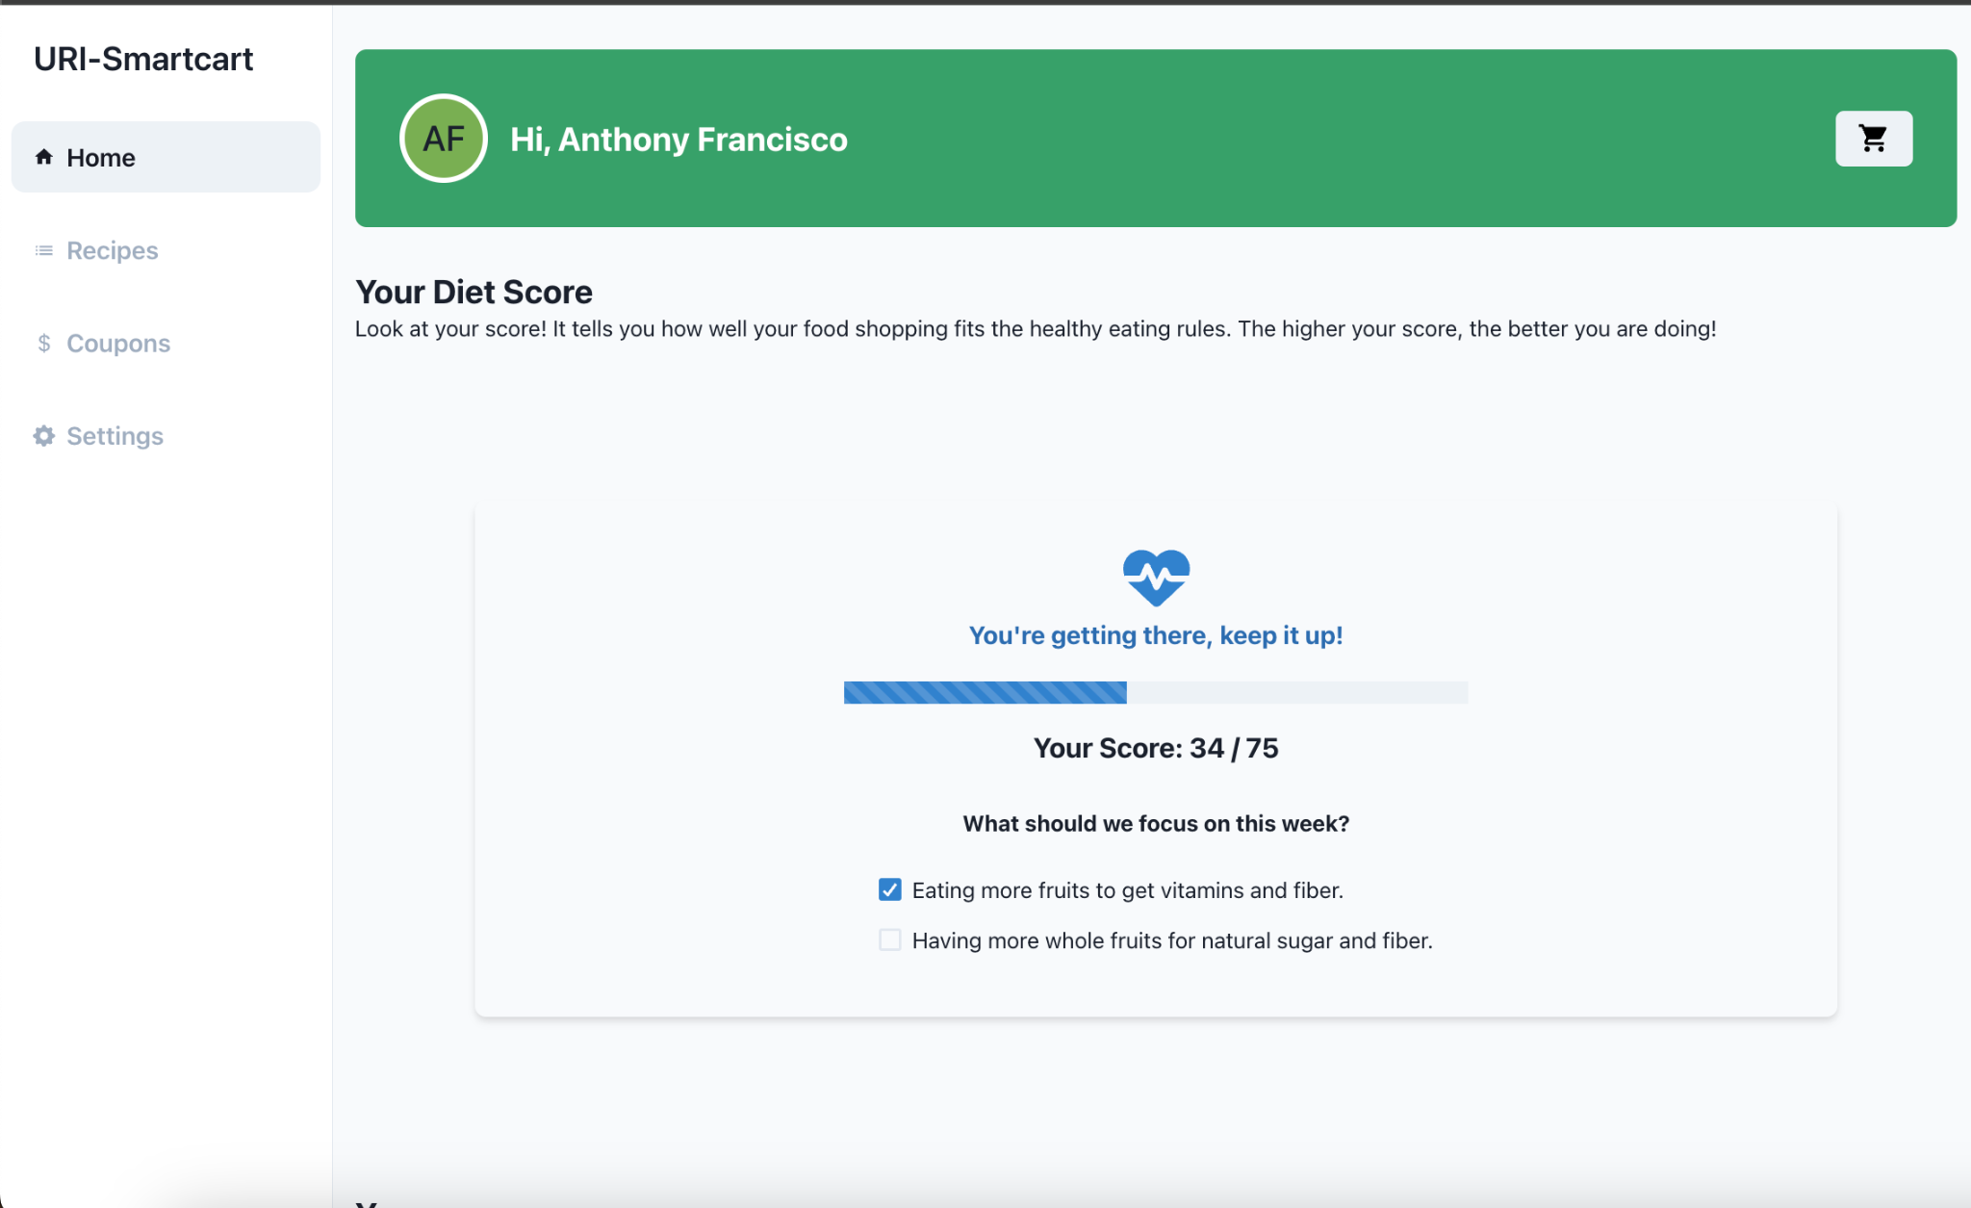
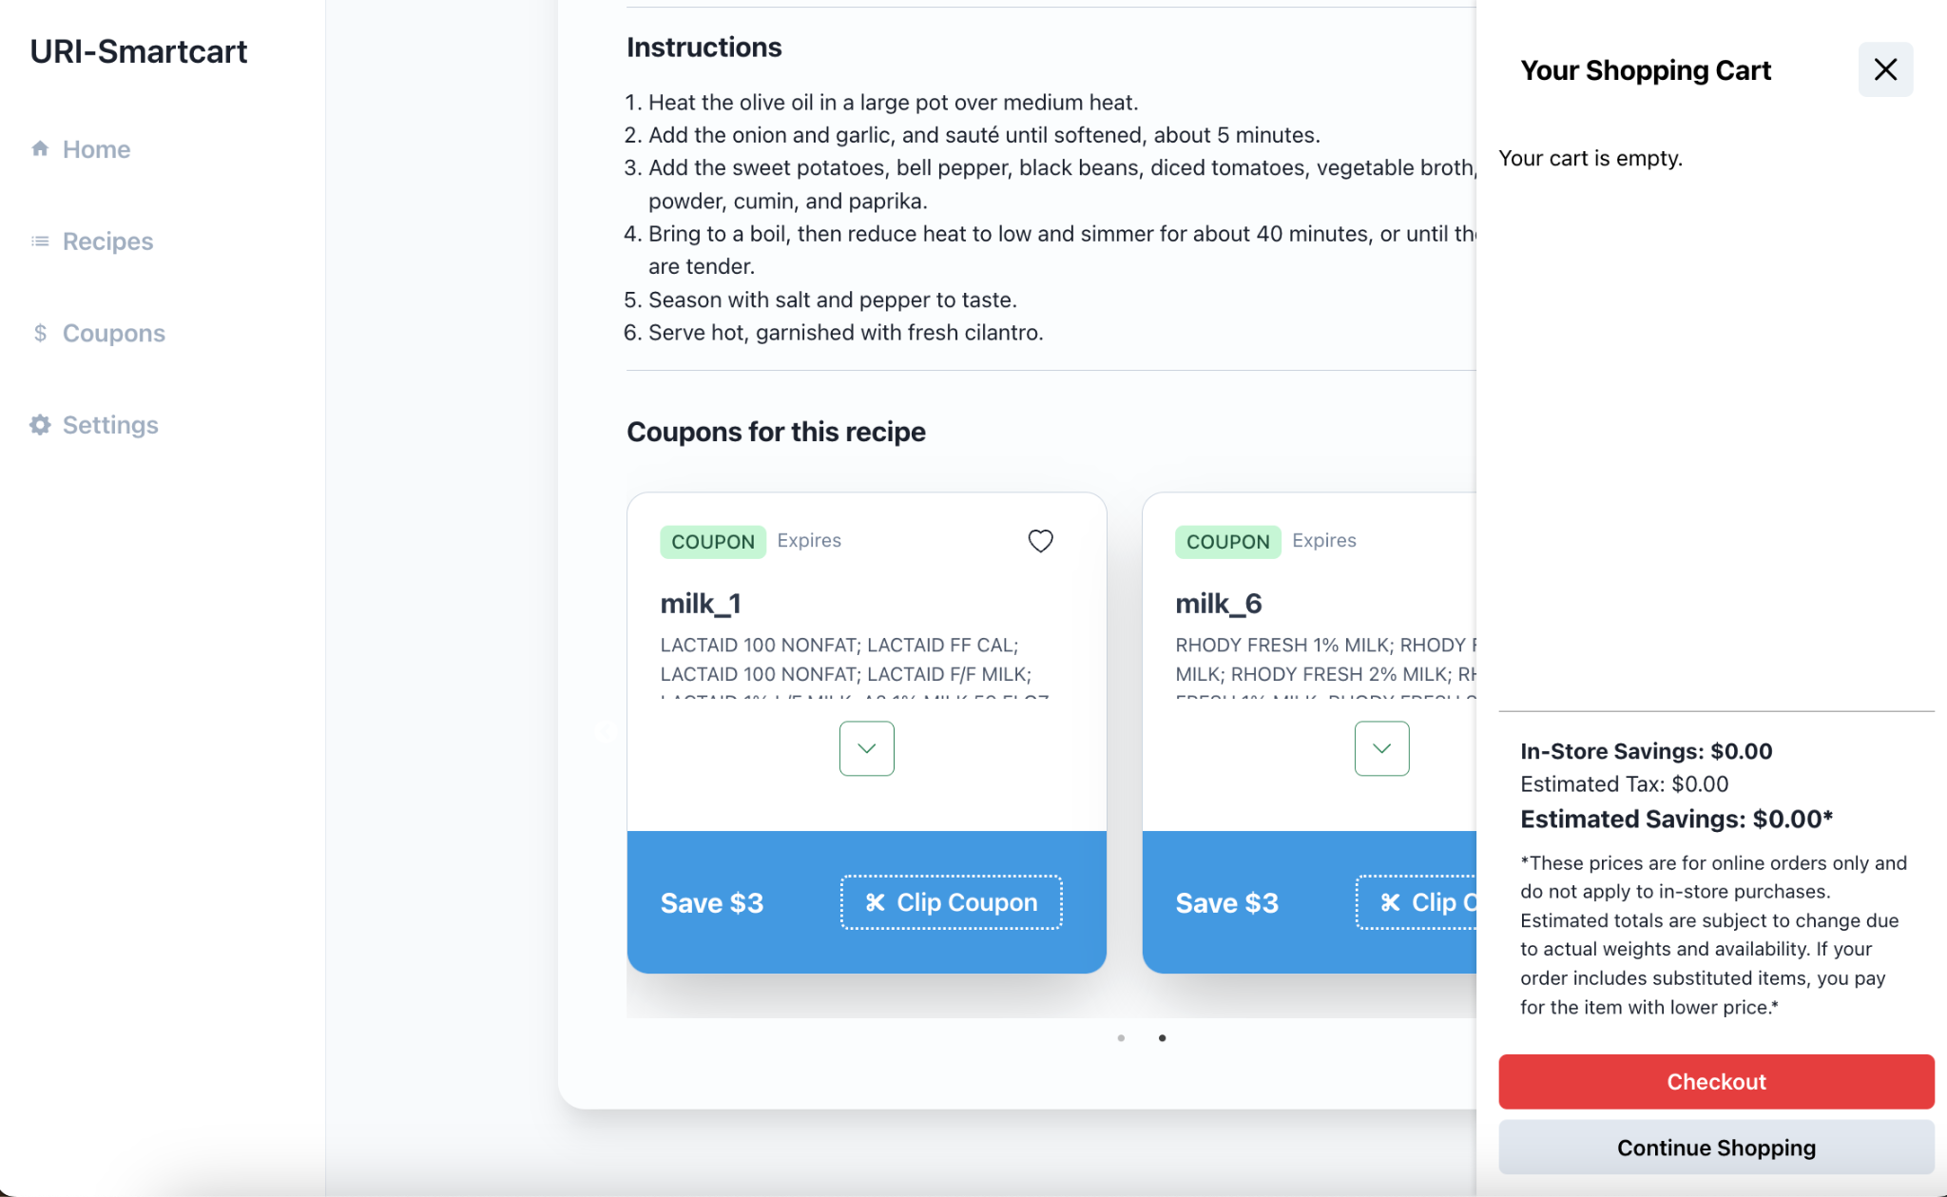

Slide 4
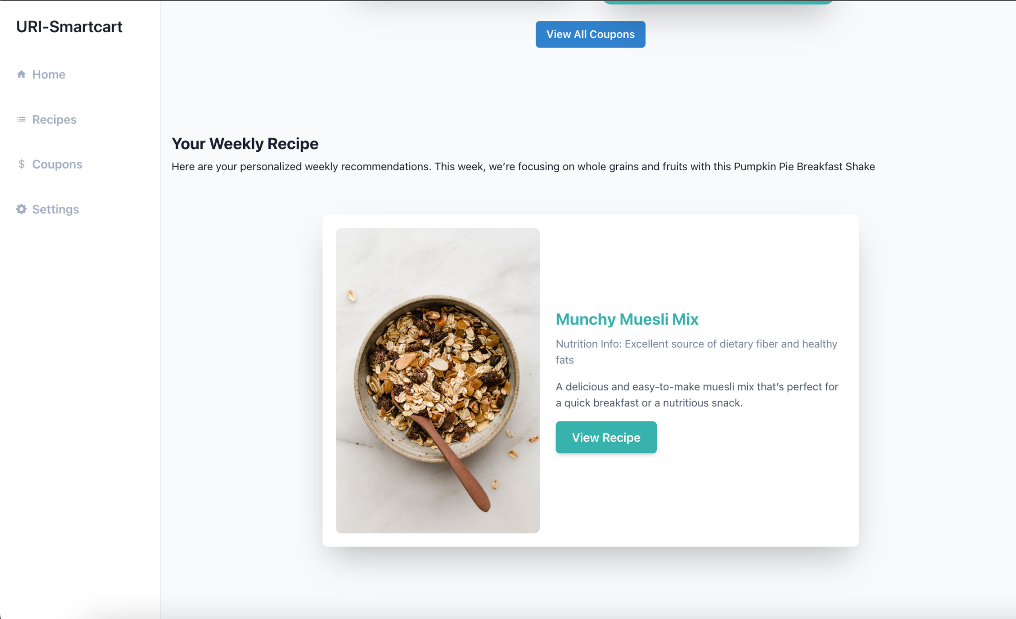

Slide 5
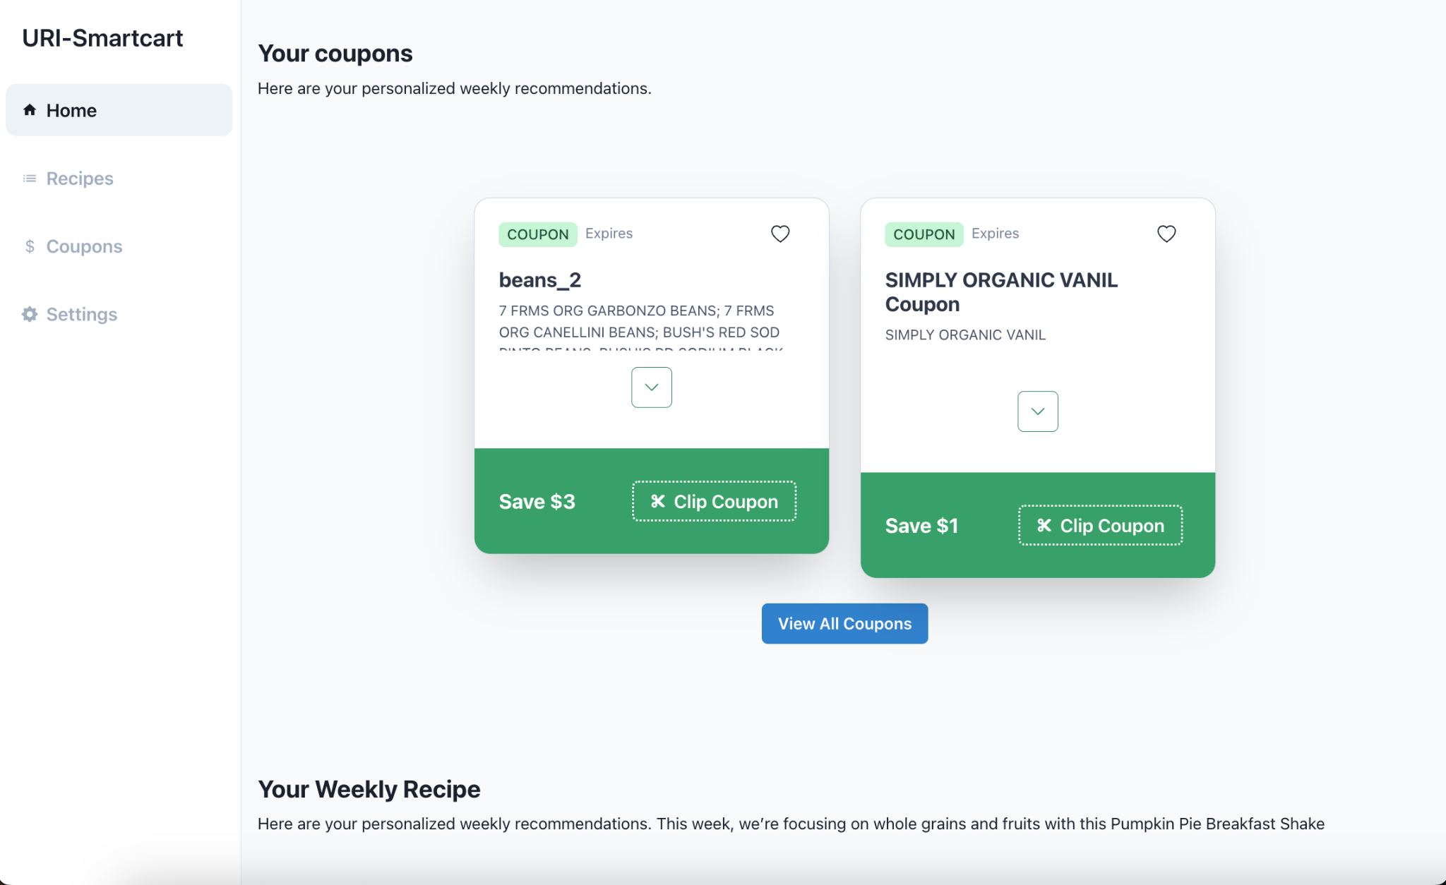

Slide 6
Smartcart
Timeframe
  Oct 2023
  Apr 2023

Slide 7
PROJECT TITLE
Timeframe
  Start date
  End date

Slide 8
PROJECT TITLE
What we accomplished
  Express Server (MVC architecture)
  DynamoDB → MySQL/Sequelize
  SSR Next.js App
  Recommender Algorithms

Slide 9
Lessons Learned
What went well? What could we have done differently?
  Finished sprints by timelines
  More engineers
  Clarification of functional requirements

