Slide 1
Improving habitat suitability models to understand how Mesophotic Coral Reef distribution will respond to climate change
Philip F. Yang, University of Rhode Island Graduate School of Oceanography
PhD student, philip_yang@uri.edu
Mentor: Dr. Andrew Davies, URI GSO and Biological Sciences
davies@uri.edu
1/19/2024

Slide 2
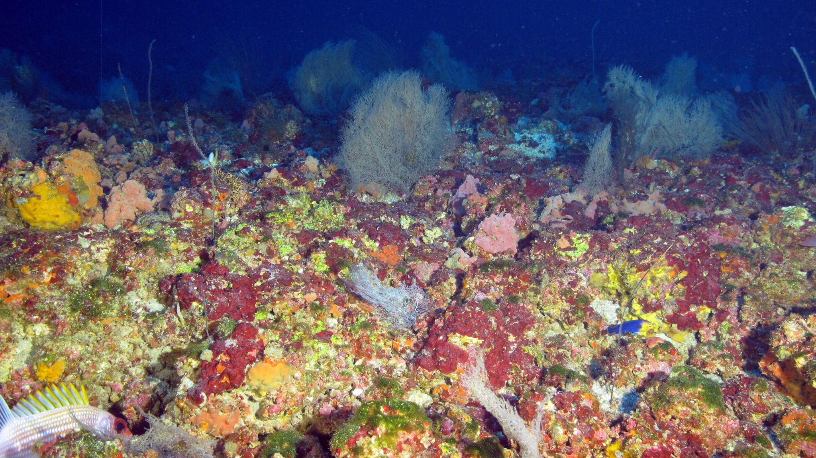
Light-dependent mesophotic coral reef in the Gulf of Mexico
Worth millions of US dollars in ecosystem services (e.g., fisheries) per year
Depth: 30-150 m or 100 to 500 ft
Why do we care?
Serve as complex structures that create habitat for many different organisms and healthy
Diverse mesophotic coral reef in NOAA Flower Garden Banks National Marine Sanctuary, Gulf of Mexico

Slide 3
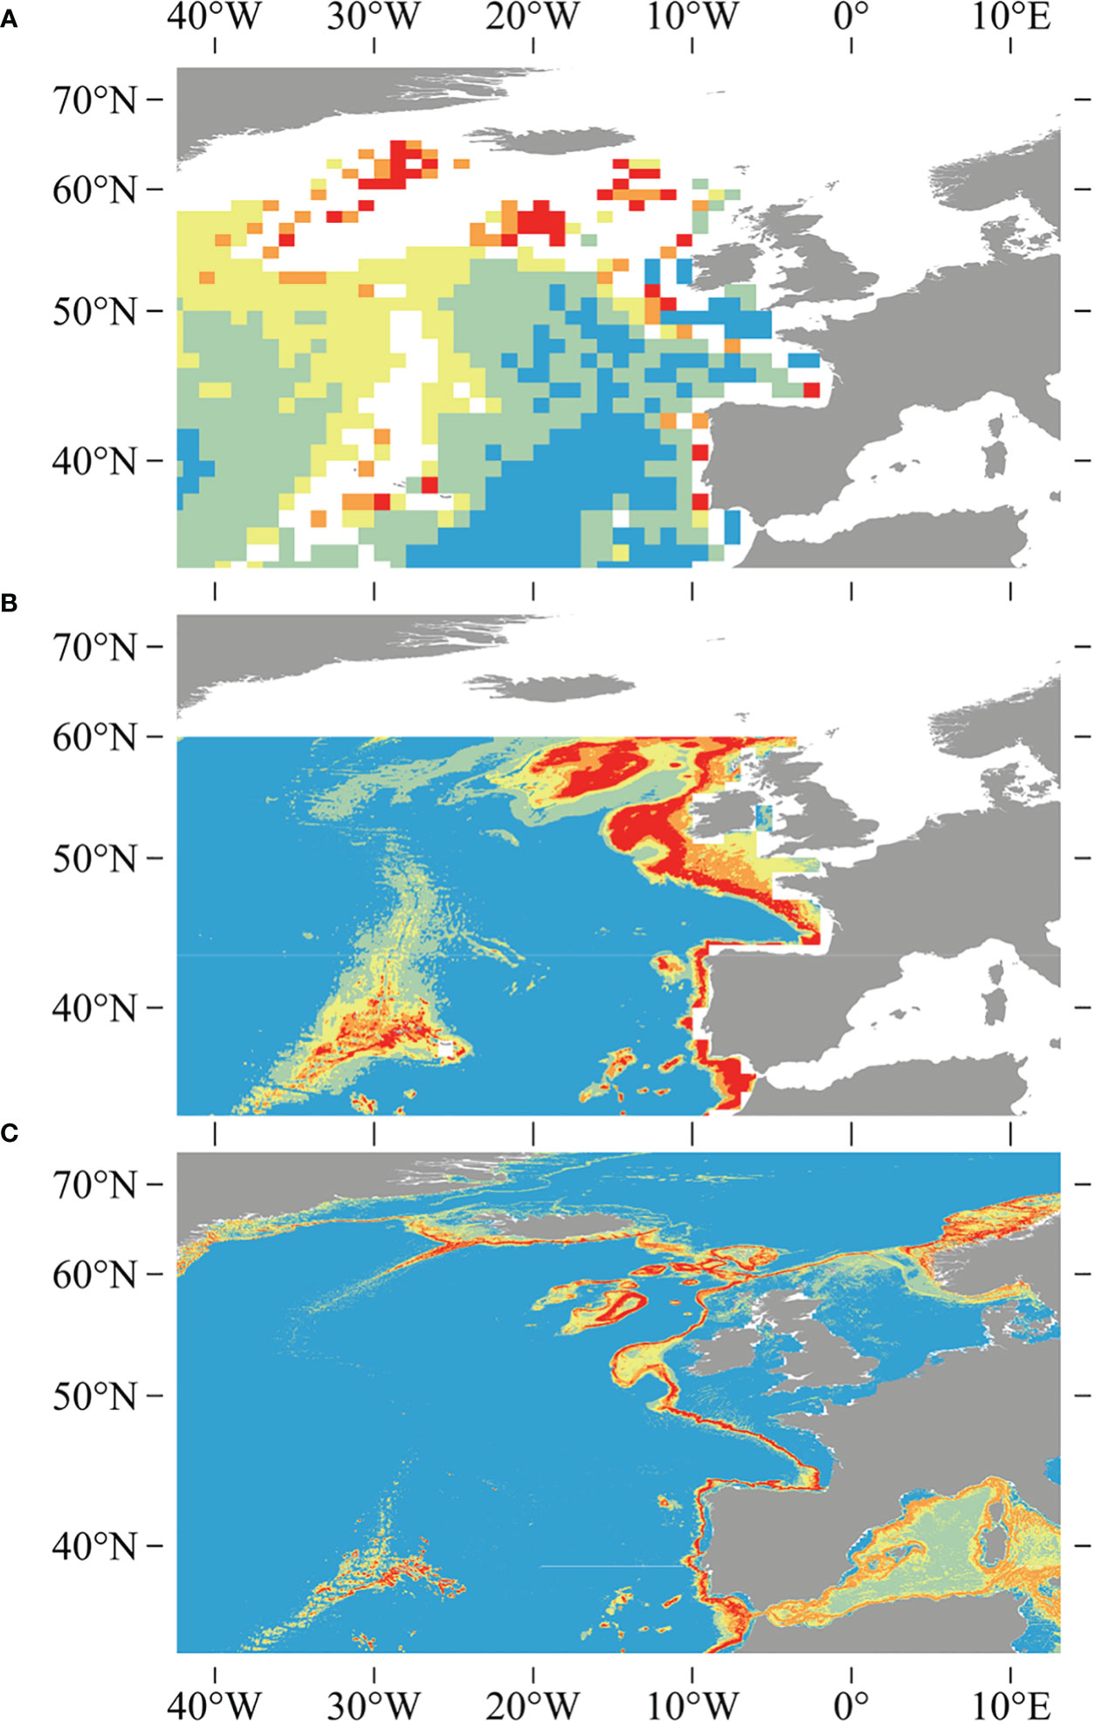
Improving habitat suitability models to understand how Mesophotic Coral Reef distribution will respond to climate change
Studying species distributions in understudied parts of the world is challenging!
Suitability models are based on niche theory and make sense of the world in grids!
Predict the occurrences of coral in places we haven’t studied yet (money, time and effort)
Modeling efforts are limited by environmental data and known occurrences - better over time
The difference between a model for Desmophyllum pertusa over time.
(A) Davies et al. 2008
(B) Davies and Guinotte 2011
(C) Tong et al. 2023
Notes:
This example is for deep-sea coral (50-2000 m) Lophelia (now Desmophyllum) pertusa that my advisor worked on previously in the Eastern Atlantic ocean
This is the quick explanation for the project, now let me share some goals, time frame, and what I hope to learn.

Slide 5
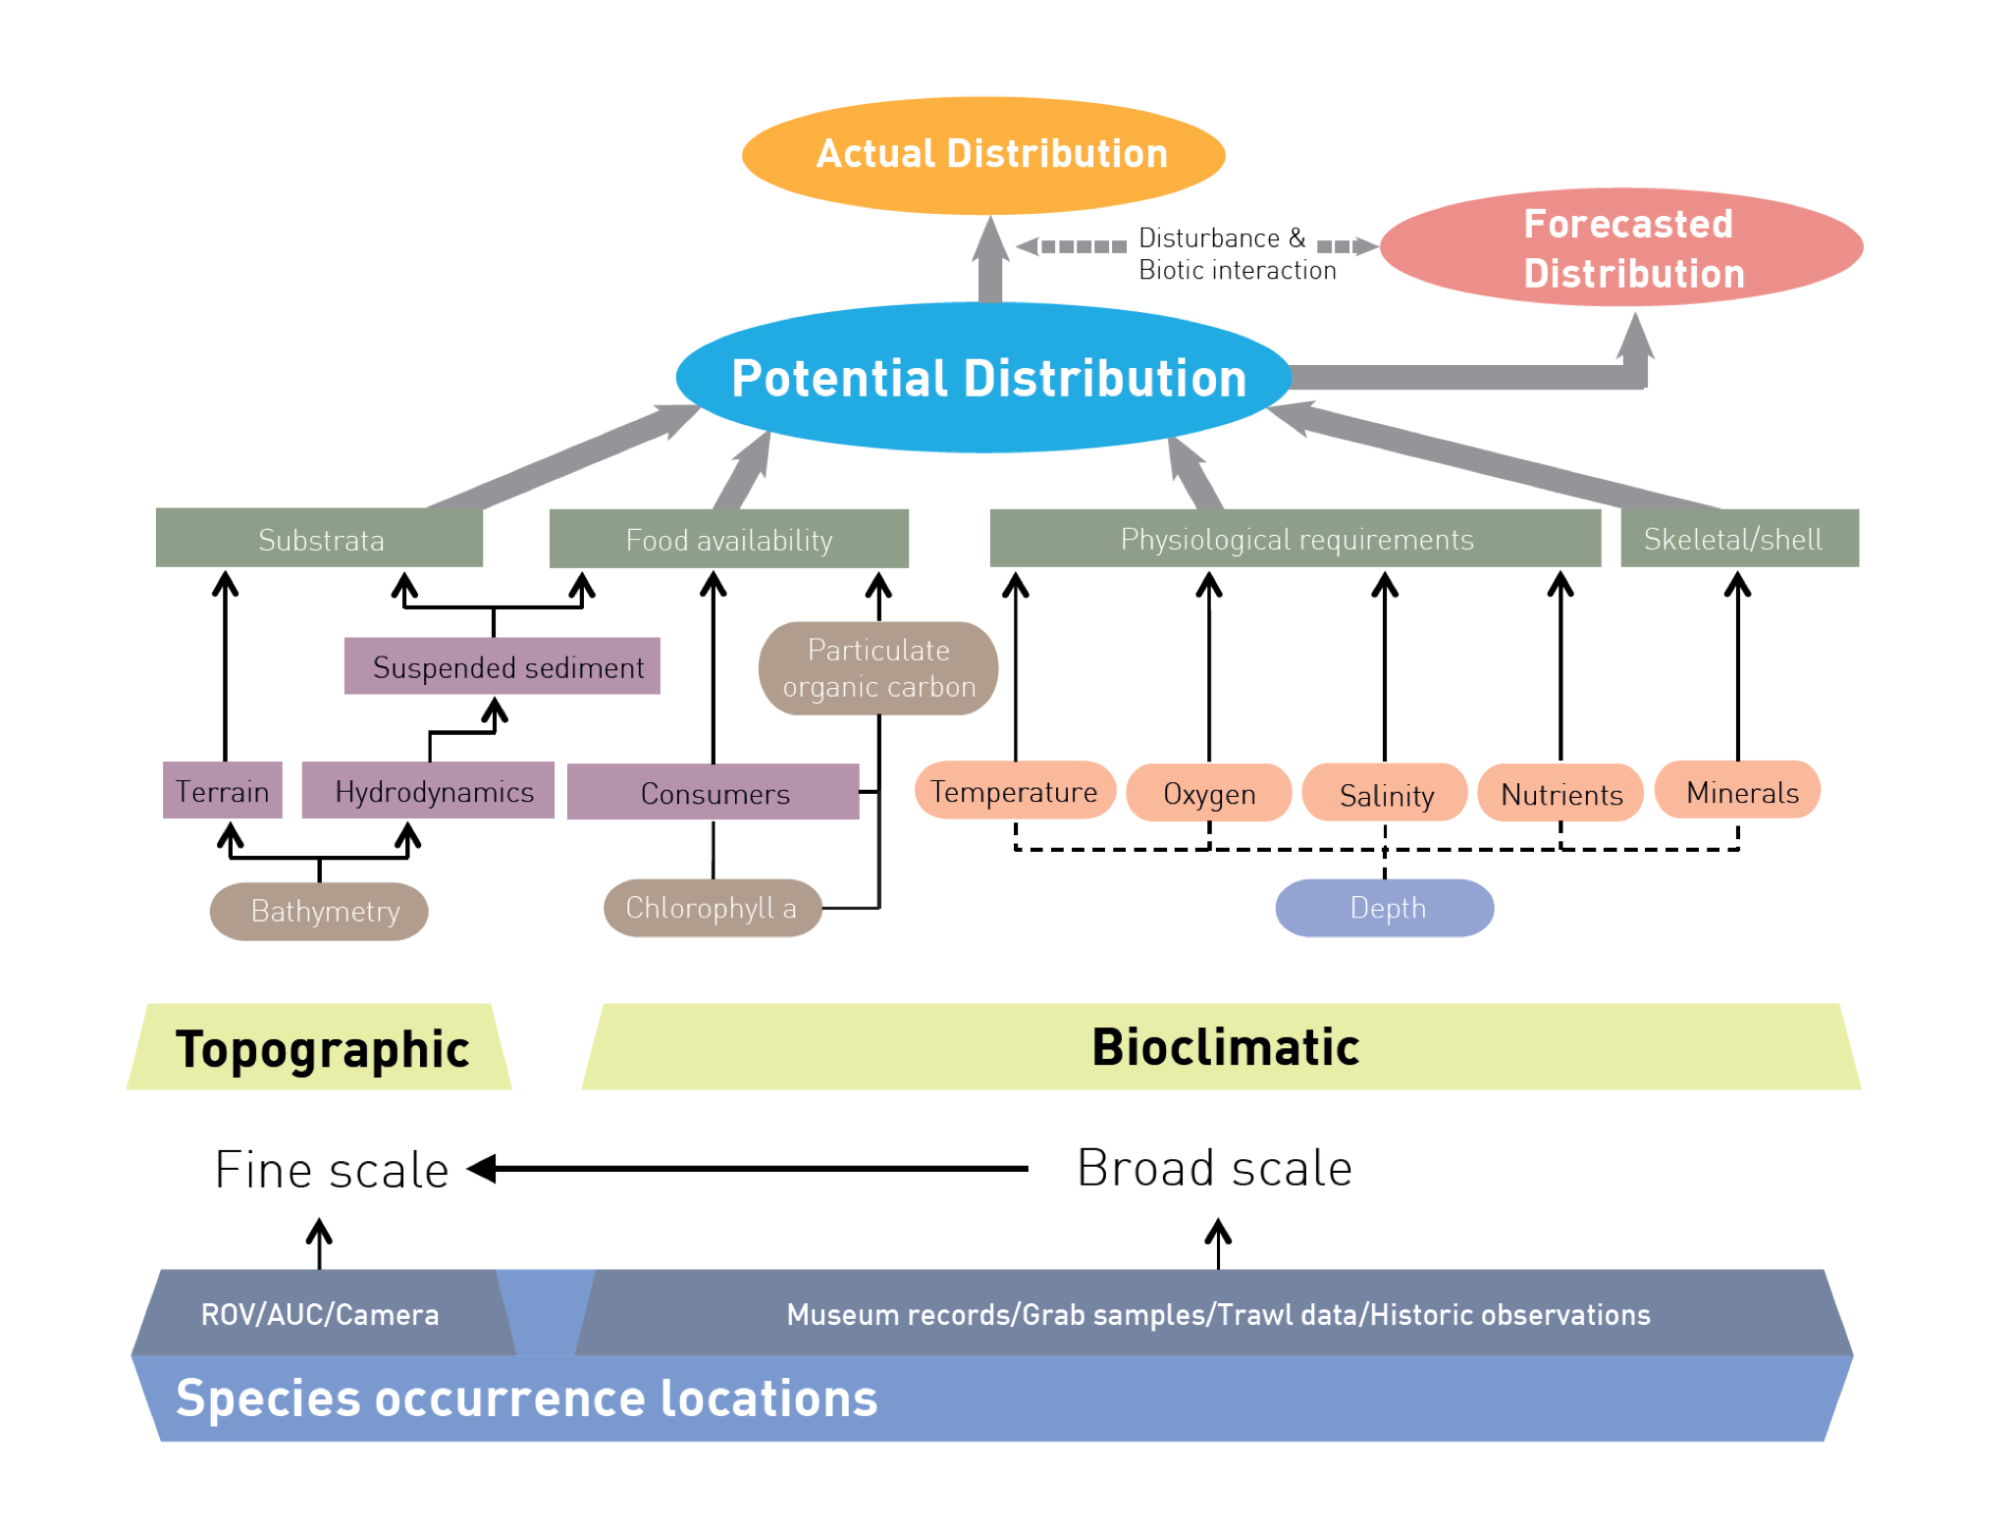

Slide 6
Improving habitat suitability models to understand how Mesophotic Coral Reef distribution will respond to climate change
Time frame
Start: 1 Jan 2024
End: 30 June 2024
Month | Jan | Feb | Mar | Apr | May | Jun
Goals | - Launch Presentation - Start collecting and organizing data - File structure - Choose the types of models appropriate for the data type | - Build environmental layers; particularly high resolution multibeam for bathymetry - Cont. with data collection | - Combine all inputs and start coding model into UNITY - Organize how outputs sort - First model run | - Start to run multiple types of models to compare - Start analyses | - Cont. analyses - More model runs if needed | - Wrap presentation - Start writing up results and pursue higher analyses
Notes:
Here is a list of some of the goals in my time frame. You can see that I plan to start running models in April and May after data collection, coding, and organization.

Slide 7
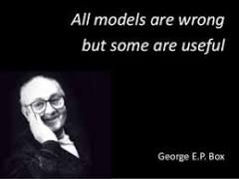
Improving habitat suitability models to understand how Mesophotic Coral Reef distribution will respond to climate change
What I hope to learn
Will high resolution multibeam bathymetry increase model real-world accuracy of local scales? By how much?
How will changing environmental variables concurrently change distribution predictions at local scales?
Can we use this analysis to find more mesophotic coral reefs in the Gulf of Mexico and beyond?
Will this type of local distribution prediction help local environmental managers in the face of climate change?
Notes:
George Box once said

Slide 8
Improving habitat suitability models to understand how Mesophotic Coral Reef distribution will respond to climate change
Goals for Next Month
Collect best-available (presence-absence?) data
Start building and validating environmental layers

