Slide 1
Multimodal Analysis of Mental Health Rhetoric on TikTok
Student: Nathaniel Nichols, University of Rhode Island
nnichols@uri.edu
Mentor: Ammina Kothari, University of Rhode Island akothari@uri.edu
Date: February 16, 2024

Slide 2
Multimodal Analysis of Mental Health Rhetoric on TikTok
Prolonged time spent on social media has been associated with increased risks of mental health difficulties, including depression, inattention, conduct problems, loneliness and other risky behaviors, and fear of missing out (Barry et al., 2017; Brunborg & Andreas, 2019; Oberst et al., 2017; Odgers & Jensen, 2020; Vannucci et al.,2020; Zenone & Barbic, 2021). However, social media has also been identified as a resource for mental health support, as well as cultural activism (Naslund et al., 2020; Power et al., 2020; Divon & Ebbrecht-Hartmann, 2022). A growing number of licensed therapists and mental health professionals identified as mental health influencers (MHI) share content focusing on psychoeducation and anecdotes from their professional and lived experiences (Triplett et al., 2022) on TikTok. Our project explores the mental health discourse on TikTok in three languages - English, Portuguese, and Arabic by MHIs to examine linguistic and visual differences in how mental health-related topics are presented by expert and regular influencers. The multimodal comparative analysis examines how these accounts use video, text, images, and sound to discuss mental health-related information in three languages (Arabic, English, and Portuguese) that resonate with their audience.

Slide 3
Multimodal Analysis of Mental Health Rhetoric on TikTok
There are three main objectives of this study:
Identify the dominant mental health-related topics on TikTok in the three countries.
Determine if there are differences in mental health information by language or culture and whether the accounts contributed to mental health literacy.
Test the efficacy of using computational tools to conduct multi-modal analysis on TikTok.

Slide 4
Multimodal Analysis of Mental Health Rhetoric on TikTok
Milestone#1: determine project scope, HPC access, launch presentation, and set up project on github. (January - February)
Milestone#2: organize data set, and finalize relational database schema. (February)
Milestone#3: complete data analysis (March - April)
Milestone#4: wrap up project, update project git and documentation, wrap presentation. (May - June)

Slide 5
Multimodal Analysis of Mental Health Rhetoric on TikTok
What I hope to learn
Audio, image and video interaction with Python
Web scraping and front-end web design elements
Hands-on experience of a data science-oriented profession

Slide 6
Multimodal Analysis of Mental Health Rhetoric on TikTok
Algorithm Steps
Input list of Tik Tok user URLs
Scrape video links from user pages
Download videos (stored on Unity)
Process audio and video data

Slide 7
Multimodal Analysis of Mental Health Rhetoric on TikTok
Video data we’ve been able to collect so far:
Audio transcript (original and translated)
Subtitle transcript (original and translated)
Facial presence
Dominant color
Average brightness
Duration

Slide 8
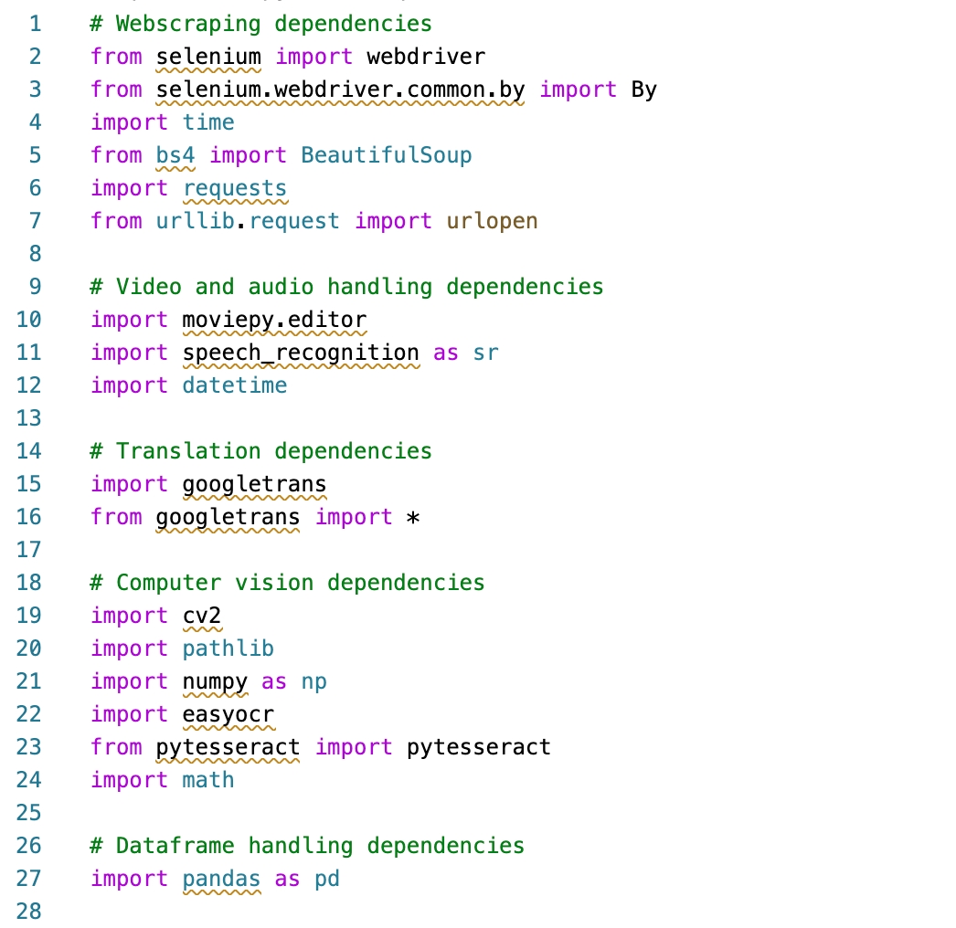
Multimodal Analysis of Mental Health Rhetoric on TikTok
Python Libraries Used

Slide 9
Multimodal Analysis of Mental Health Rhetoric on TikTok
Goals for Next Month
Fine-tune audio and video text processing
Organize scripts and functions
Connect program to Unity for data storage
Collect full dataframe

Slide 10
Multimodal Analysis of Mental Health Rhetoric on TikTok
Help needed (if any)
Need more training to work with Unity (URI offers a workshop on 02/26)
Access to external GPU (not necessary, but would be helpful for OCR)

